Slide 1

Linguistic levels of structure
Sound
Phoneme
ð iː z b juː t ə f ʊ l w ɪ m ɪ n s ɛ d w iː w ɜː t r uː m ɛ n
Morpheme
These beauti-ful women said we were true men
Word
These beautiful women said we were true men
Phrase
These beautiful women said: “We were true men.”
Clause
C(These beautiful women said: “C(We were true men.)”)
Sentence
These beautiful women said: “We were true men.”
Meaning
?

Slide 2
Word classes & inflection
Open class
(content / lexical / autosemantic words)
Closed class
(Function / structure words)
Verb
Determiner
Noun
Conjunction
Adverb
Numeral
Preposition
Adjective
Interjection
Pronoun
Have inflection
Building blocks
The glue

Slide 3
Word classes -> Adverbs
Open class
(content / lexical / autosemantic words)
Closed class
(Function / structure words)
Verb
Determiner
Noun
Conjunction
Adverb
Numeral
Preposition
Adjective
Interjection
Pronoun
Have inflection
Building blocks
The glue

Slide 4
Adverb classes
Order: M -> P -> T (alphabetically increasing)
More
Adverb of affirmation & negation
Adverb of
degree
(To what extent?)
Adverb of manner
(How?)
Adverb of
place/space
(Where?)
Adverb of
time
(When? How long? How often?)
More
More
More
Yes, a very lovely singer sang the song very well there yesterday.
However, she didn’t often do that well.
Adverb of
conjunction
- Adverbs add circumstantial information about the mentioned action, event or process, or intensify an adjective or another adverb.
- For further reference:
http://www.englishmirror.com/english-grammar/adverb.html
http://www.edufind.com/english-grammar/adverbs/
More

Slide 5
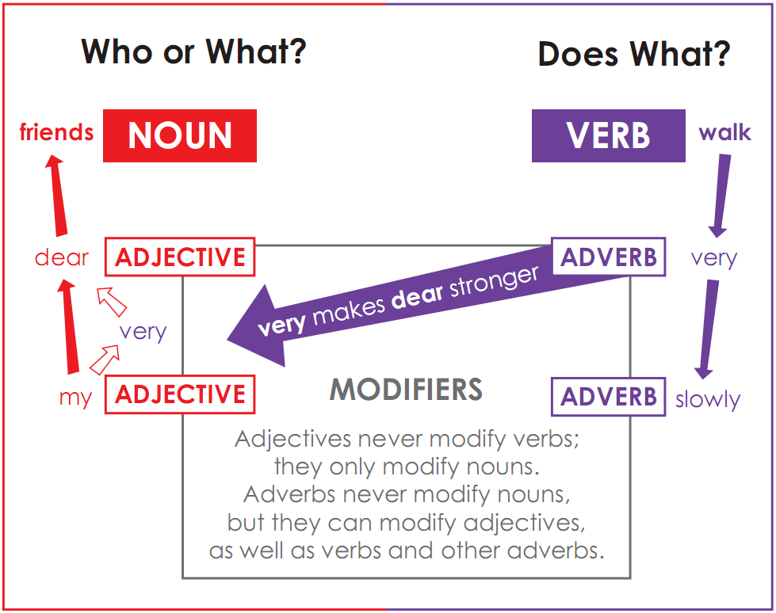
Adverbs vs. Adjectives

Slide 6
Word classes -> Pronouns
Open class
(content / lexical / autosemantic words)
Closed class
(Function / structure words)
Verb
Determiner
Noun
Conjunction
Adverb
Numeral
Preposition
Adjective
Interjection
Pronoun
Have inflection
Building blocks
The glue

Slide 7
Pronoun classes
I know him. I know myself.
This is my hat. That is yours.
Number | Person | Personal (Subjective) | Personal (Objective) | Reflexive | Possessive | Possessive adjective
Singular | 1st | I | Me | Myself | Mine | My
 | 2nd | You | You | Yourself | Yours | Your
 | 3rd | She He It | Her Him It | Herself Himself Itself | Hers His Its | Her His Its
Plural | 1st | We | Us | Ourselves | Ours | Our
 | 2nd | You | You | Yourselves | Yours | Your
 | 3rd | They | Them | Themselves | Theirs | Their
Pronouns have the main function of substituting for nouns, once a noun has been mentioned in a particular text.

Slide 8
Pronoun classes
Interrogative
Also called interrogative adjective
Relative
Who were you talking to?
What is the time?
Which train are you catching?
Which is yours?
Why did you do that?
How is he?
How old is he?
The boy who has lost his ball…
The boy whom I met…
The boy that I met…
The boy whose hat was red…
The table which I bought…
The day when I was still a man…
The place where you were born…
Also called interrogative adverb
Also called relative adverb
Demonstrative
Demonstrative
Infinite
This is a good idea.
These are good ideas.
That is an interesting point.
Those are interesting points.
What are these / those?
All is yours now.
Something is better than nothing.
Hi everyone.
Many know I am innocent.
A few of you have gone.
Pronouns have the main function of substituting for already-mentioned nouns. In questions, pronouns can also substitute for adjectives and adverbs.

Slide 9
Small test
Identify the word classes of each word
How I spend my life is a private matter.
You can live your life how you want.
Which hat is yours? The red or blue one?
Hey man, do you want to get kicked?
We must stay together whatever happens.
Whatever project he works on is always successful.
Whatever happens is none of your business.

Slide 10
Small test
Identify the word classes of each word
There isn’t much time left.
How much money have you got?
How much did you pay?
He didn’t say much. He didn’t say anything.
Things haven’t changed much.
A much loved member of the family
Loach’s latest film is much the best thing he’s done.

Slide 11
Word classes -> Prepositions
Open class
(content / lexical / autosemantic words)
Closed class
(Function / structure words)
Verb
Determiner
Noun
Conjunction
Adverb
Numeral
Pre-
position
Adjective
Interjection
Pronoun
Have inflection
Building blocks
The glue

Slide 12
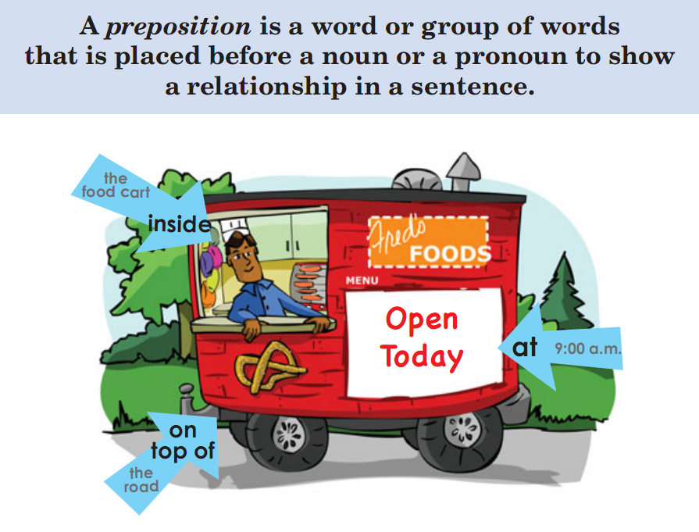
Prepositions

Slide 13
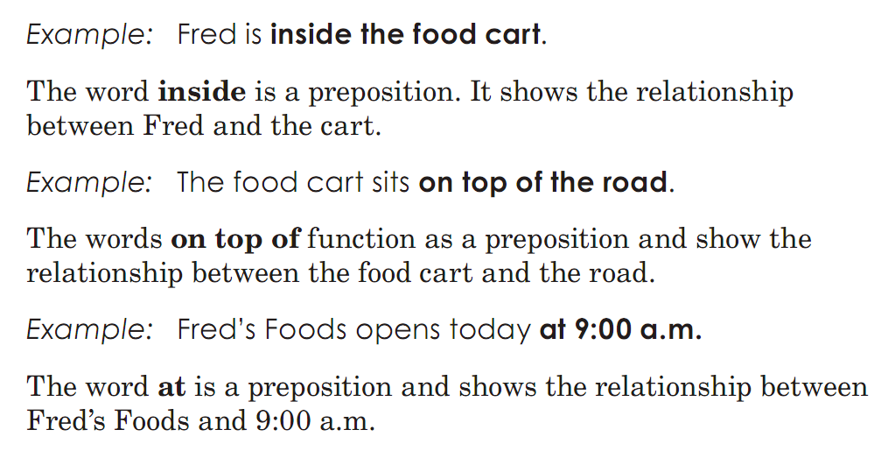
Prepositions
Single-word preposition
Compound preposition
MORE

Slide 14
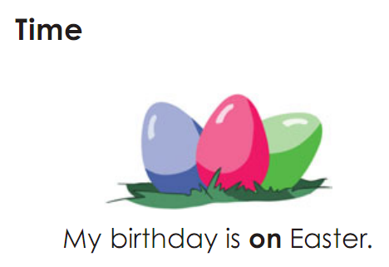
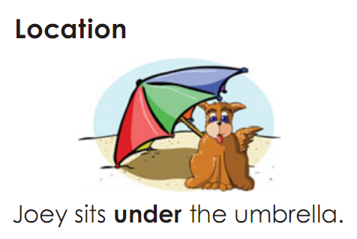
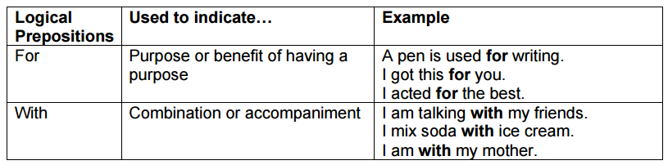
Preposition classes
M
O
R
E

Slide 15
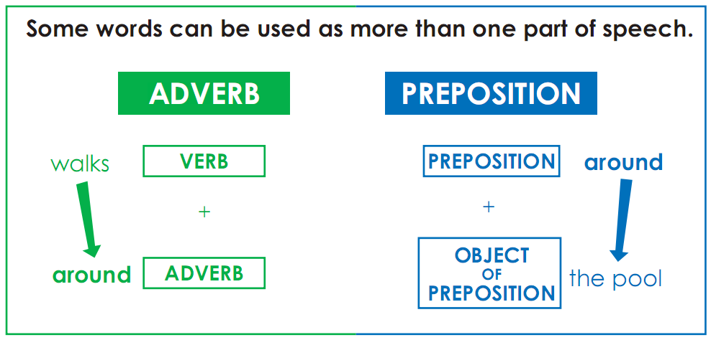
Prepositions vs. Adverbs
He came by the office in a big hurry. (by = preposition)
He came by his fortune honestly. (by = particle)
She turned up that street. (up = preposition)
She turned up something new. (up = particle)

Slide 16
Small test
Identify the word classes of each word
I am taller than she is.
He is smarter than us all.
The tickets had all been sold.
They forgot all about everything else.
I want to hear all the details.
Before we do anything else, we must sit down and make a list.
What else will you say? - There isn’t much else to tell you.

Slide 17
Word classes -> Conjunctions
Open class
(content / lexical / autosemantic words)
Closed class
(Function / structure words)
Verb
Determiner
Noun
Con-junction
Adverb
Numeral
Preposition
Adjective
Interjection
Pronoun
Have inflection
Building blocks
The glue

Slide 18
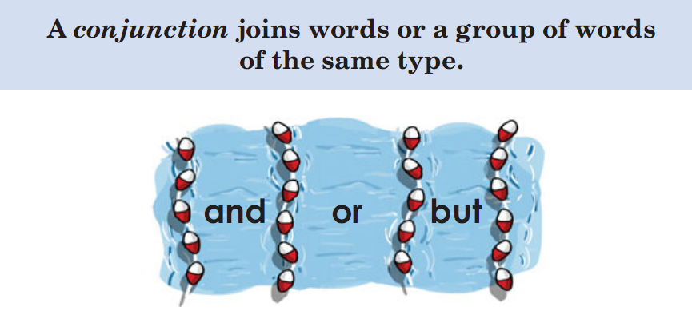
Conjunctions

Slide 19
Conjunction classes
Coordinating
Subordinating
Anna and Jake
Green or pink
Ben walks or takes the bus.
He did that for Jake and for Maria
I went to the pool, and she went to school.
He will come when he is ready.
He will be wherever you are.
He cannot come, because he is ill.
If I knew that, I would not let it happen.
MORE

Slide 20
Word classes -> Interjections
Open class
(content / lexical / autosemantic words)
Closed class
(Function / structure words)
Verb
Determiner
Noun
Conjunction
Adverb
Numeral
Preposition
Inter-jection
Adjective
Pronoun
Have inflection
Building blocks
The glue

Slide 21
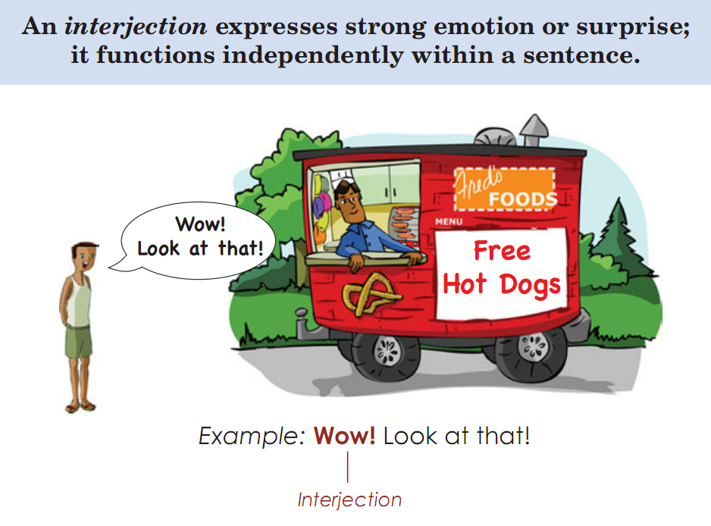
Interjections

Slide 22
Small test
Identify the word classes of each word
Wow, this damned thing is so cool.
What a lovely skeleton! You are so damned lucky to have it!
Don’t be so anxious about your future. Don’t be anxious about anything you don’t have.
Because of you, we’ll wait for the bus not for a long time, but FOREVER.
After they had visited the British Museum, the twenty little foreign visitors made their way quickly to the Houses of Parliament.

Slide 23
Small test
Identify the word classes of each word
We can but hope that things will improve.
There’s been nothing but trouble since he came.
It was in Cairo that he met Nadia. But that’s another story.
She’s 83 but she still goes swimming every day.
What we are about to do is perfectly legal. But please don’t discuss it with anyone.
A simple but effective way of filtering water

Slide 24

Any question?

